Slide 1
Progress Presentation
Group 11A:
Radu Constantinescu
Kendra Sartori
Ahmed Ibrahim
Lucian Negru
Manar Al-Robayi
Notes:
Welcome to the progress presentation of group 11A, my name is Lucian and we are joined by my teammates Radu, Kendra, Ahmed and Manar.

Slide 2
Today’s Schedule
Examples of three literature references and their uses
Old ToC vs. New ToC
Our Introduction
Three paragraphs with clear topic sentences
How we made it easy for readers to find information
Example of visuals in our report
Notes:
In today’s presentation we will discuss our use of literature references, show our improved table of contents using the given feedback, showcase our report introduction, discuss the use of clear topic sentences, show how we made it easy for readers to find information and lastly show some examples of visuals in our report. We will then conclude and have a Q&A session.

Slide 3
Literature References
B. Friedman, P. Kahn Jr. and A. Borning, "Value Sensitive Design and Information Systems", in The Handbook of Information and Computer Ethics, K. Himma and H. Tavani, Ed. Hoboken, NJ: John Wiley & Sons, Inc., 2008, pp. 69–101.
Z. Jin, ‘Chapter 3 - Importance of Interactive Environment’, in Environment Modeling-Based Requirements Engineering for Software Intensive Systems, Z. Jin, Ed. Oxford: Morgan Kaufmann, 2018, pp. 29–39.
S. Khan, A. B. Dulloo, and M. Verma, International Journal of Information and Computation Technology. International Research Publications House, 2014, pp. 133–138.
Notes:
We will now discuss our use of literature references by showing these 3 examples.

Slide 4
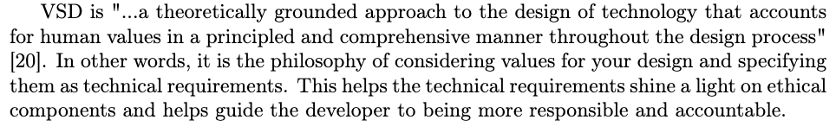
Reference 1
[20] B. Friedman, P. Kahn Jr. and A. Borning, "Value Sensitive Design and Information Systems", in The Handbook of Information and Computer Ethics, K. Himma and H. Tavani, Ed. Hoboken, NJ: John Wiley & Sons, Inc., 2008, pp. 69–101.
Notes:
In this example, we used a quote directly from the book to describe what Value Sensitive Design is. We then proceeded to elaborate on the quoted sentence using our own words.

Slide 5
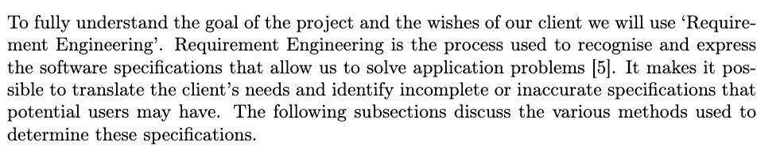
Reference 2
[5] Z. Jin, ‘Chapter 3 - Importance of Interactive Environment’, in Environment Modeling-Based Requirements Engineering for Software Intensive Systems, Z. Jin, Ed. Oxford: Morgan Kaufmann, 2018, pp. 29–39.
Notes:
In this example we defined what requirements engineering is by summarizing the contents of the chapter, namely the specified pages of the chapter, in a short paragraph. Now I will let my colleague Kendra take over for the final reference.

Slide 6

Reference 3
[8] S. Khan, A. B. Dulloo, and M. Verma, International Journal of Information and Computation Technology. International Research Publications House, 2014, pp. 133–138.
Notes:
Thank you Lucian, In this example we used the journal shown above to define two types of approaches for extracting requirements from a client, namely indirect and direct approaches.

Slide 7
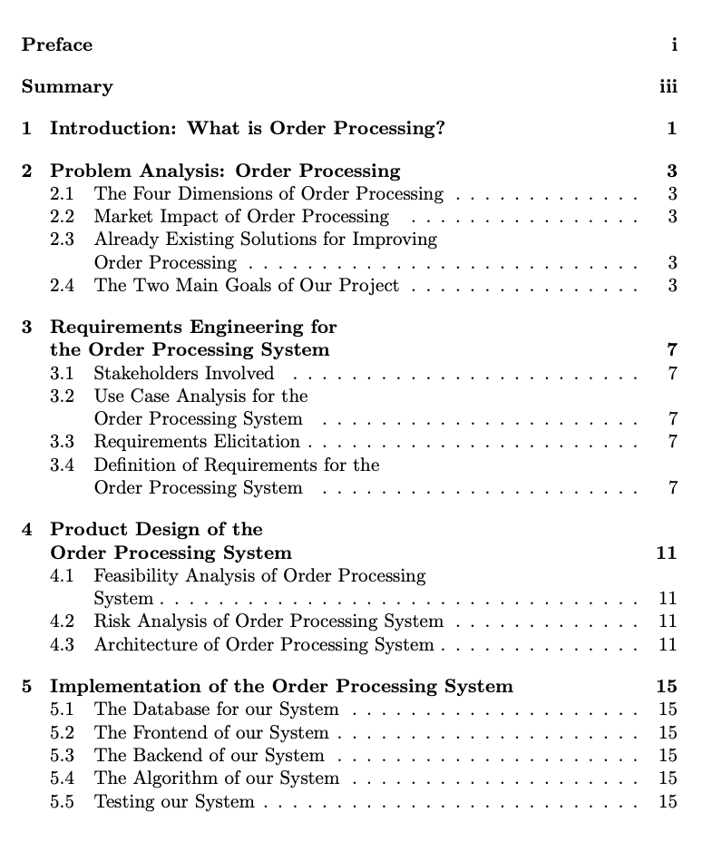
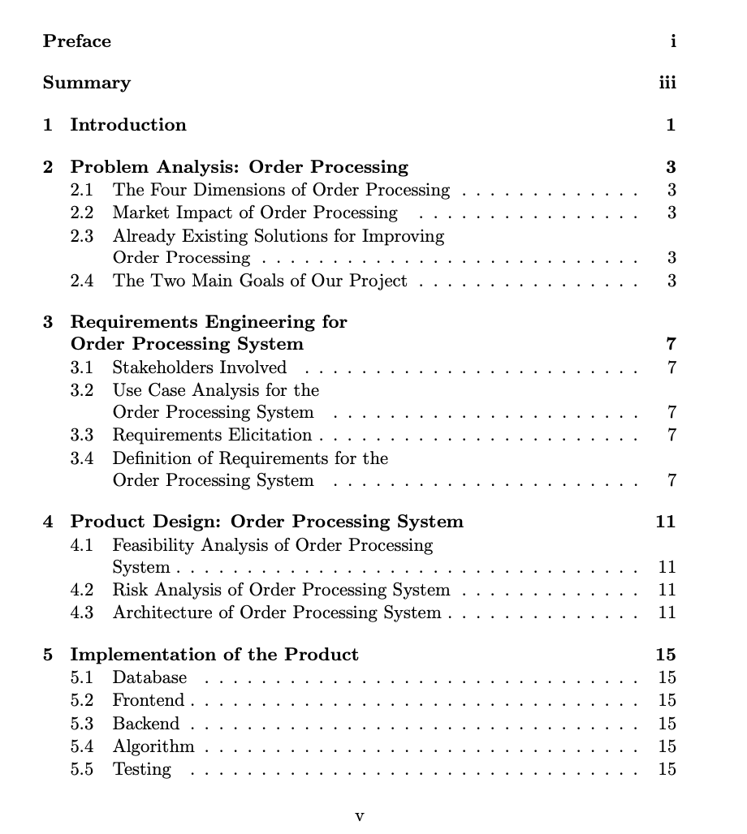
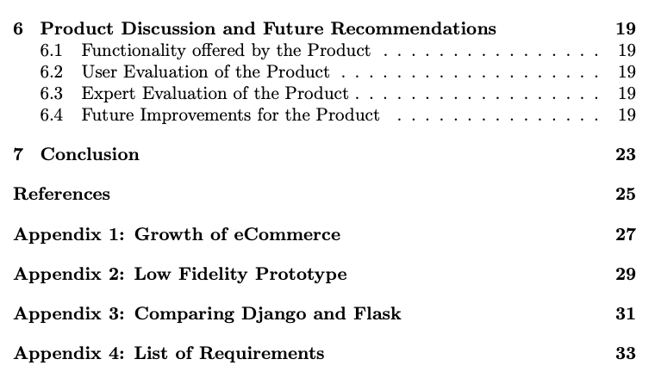
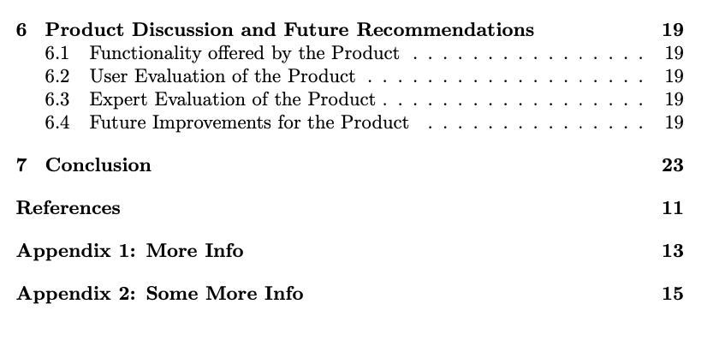
Old ToC vs. New Toc
Titles don’t describe our subject
Chapter starts at page 11 when last chapter was page 23
Filler titles instead of specific naming
Notes:
I will now be showing our improvements to the table of contents after the feedback. Firstly, we had some undescriptive chapter and section titles, we tried to fix this by mentioning the project itself more. Then, we had a small bug with the page numbering in latex, causing chapters 7 and onwards to have wrong page numbers, this was fixed. Lastly, we changed the names of the appendices, these were initially placeholder names but now have been changed as we have already added to them. Now Radu will discuss our introduction.

Slide 8
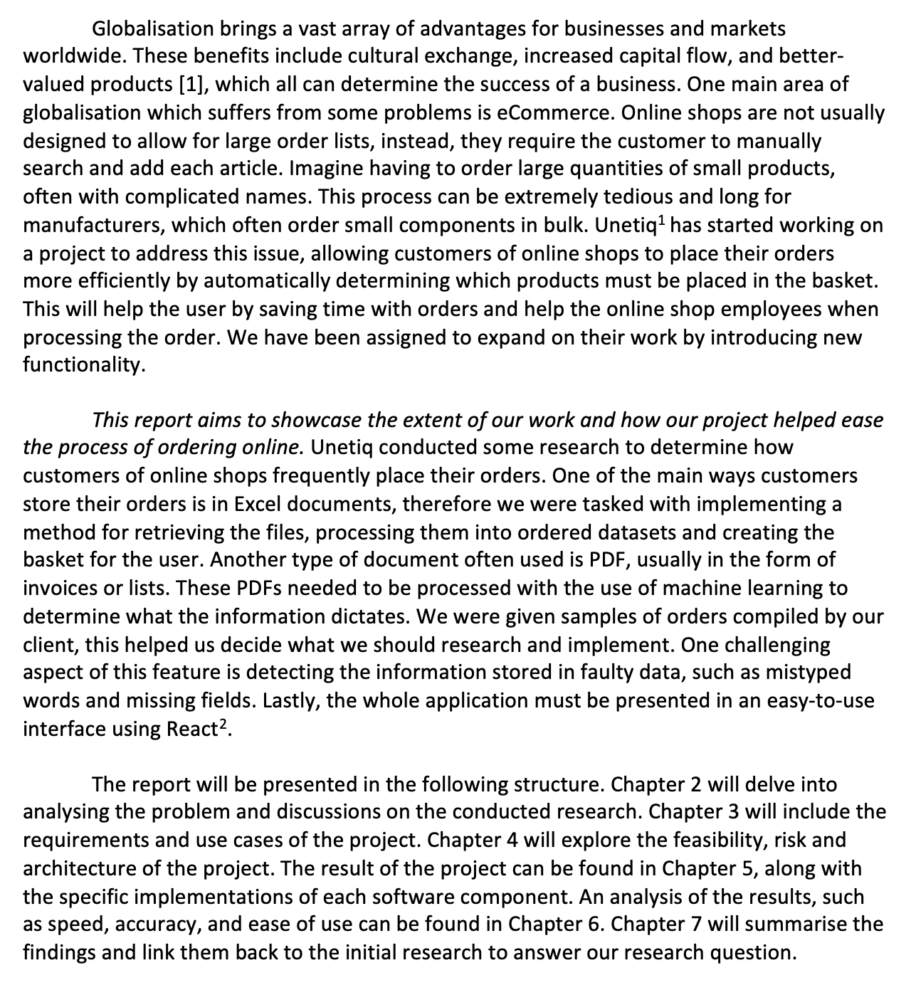
Our Introduction
Paragraph 1: Reason
Paragraph 2: Aim
Paragraph 3: Structure
Notes:
Thank you Kendra, This is the introduction we currently have for our report. As you can see it is split into 3 paragraphs and follows the form recommended by TU-Write.
The first paragraph explains the motive of the report by giving background information about eCommerce, the problem that needs solving with online orders and stresses the importance of solving it.
The second paragraph delves into the aim of our report, stated in the first sentence and in italics. It also describes our approach, the tools used and provided by the client and limitations we have encountered until now.
Lastly, the third paragraph showcases the structure the report will have and briefly explain what each chapter contains, to give the reader a clear understanding of how the chapters are connected.

Slide 9
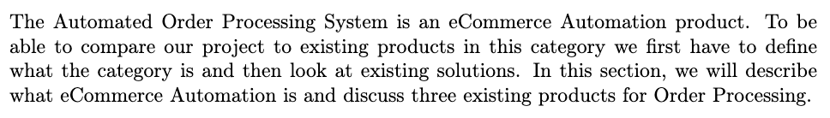
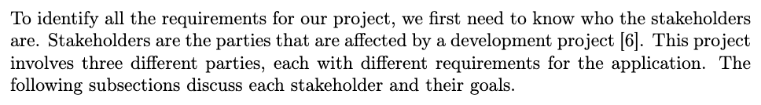
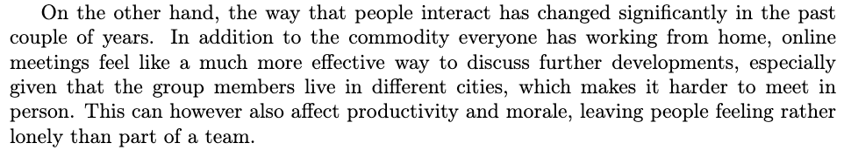
Clear Topic Sentences
***
***
Notes:
The following paragraphs illustrate the use of clear topic sentences. The first paragraph has the topic sentence at the start, and it lets the reader know that the paragraph will be about the relationship between the AOPS and eCommerce Automation. The second paragraph also has the topic sentence as the first sentence and lets the reader know that the paragraph discusses stakeholders. The last paragraph showcases the use of the topic sentence in the middle of the paragraph, which can also happen. This sentence clause indicates that the paragraph is about the effects of online meetings. Now my friend Ahmed will discuss the ways we made the report easy to read.

Slide 10
How did we make it easy for the reader?
Use of clear (sub)chapter titles
Use of a table of contents
Inclusion of a summary
Notes:
Thank you Radu. It is very important for us to consider the readers that have a limited time to read our report. Therefore, we added some components to make their information search easier.
The first of these was making sure the naming of our chapters and subchapters are clearly indicative of what information they contain and how they are related to the subject as a whole.
The second component would be the table of contents, which takes advantage of the aforementioned example, to help the reader quickly traverse to the exact page where they can find the information they’re looking for.
The final component is the inclusion of a summary at the beginning of the report, for readers that have a very limited time and only wish to know about the purpose, main points and findings of the report.
My colleague Manar will now showcase a use of Visuals in our report.

Slide 11
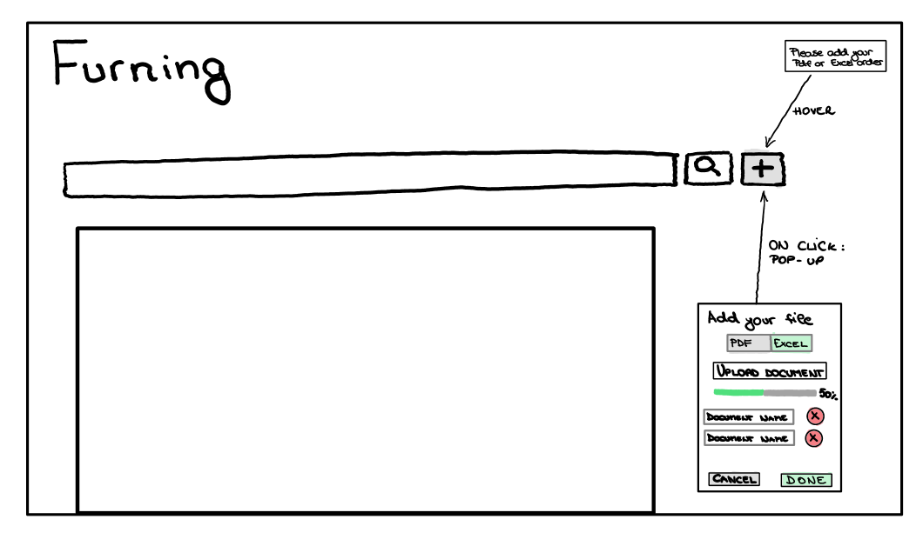
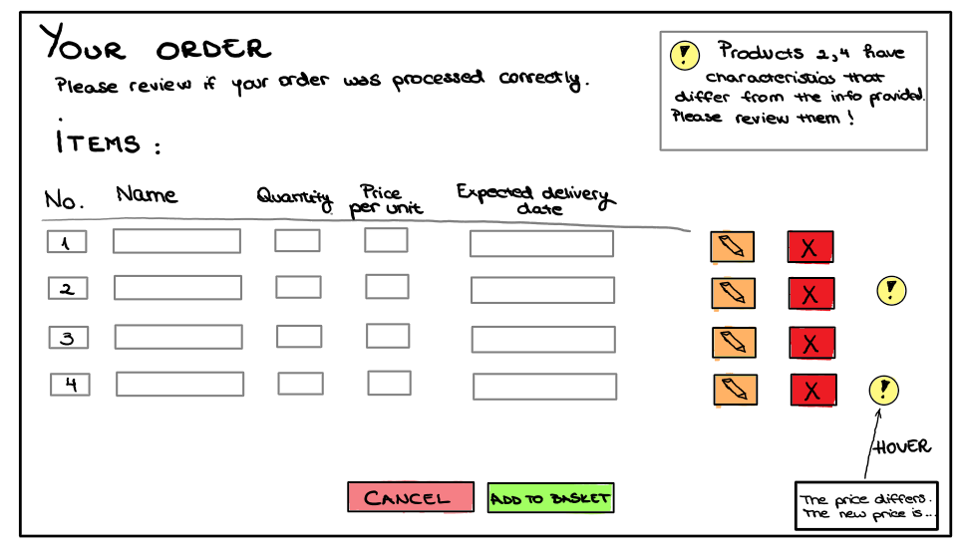
Use of Visuals
Notes:
Thank you Ahmed. We used the following prototype to showcase the planned look of our frontend. These images are in the appendix of the report and referenced in the design chapter. We decided to include them in the appendix as to not disrupt the flow of the text with two large images.

Slide 12
Conclusion
Notes:
To conclude, we believe we are on track with the report. We have been constantly adding to it as we implement the project and believe we won’t struggle or have rush to submit it in time.

Slide 13
Questions?
Notes:
We will now be answering your questions.

